Slide 1

PROJECT ON ANALYTICS
TITLE: EXPENSE ANALYSIS TO INCREASE SAVINGS FOR PURCHASING A SCOOTER
NAME : VASAVI KARNATI
AF ID : AF05259574
BATCH: ANP-D6582

Slide 2
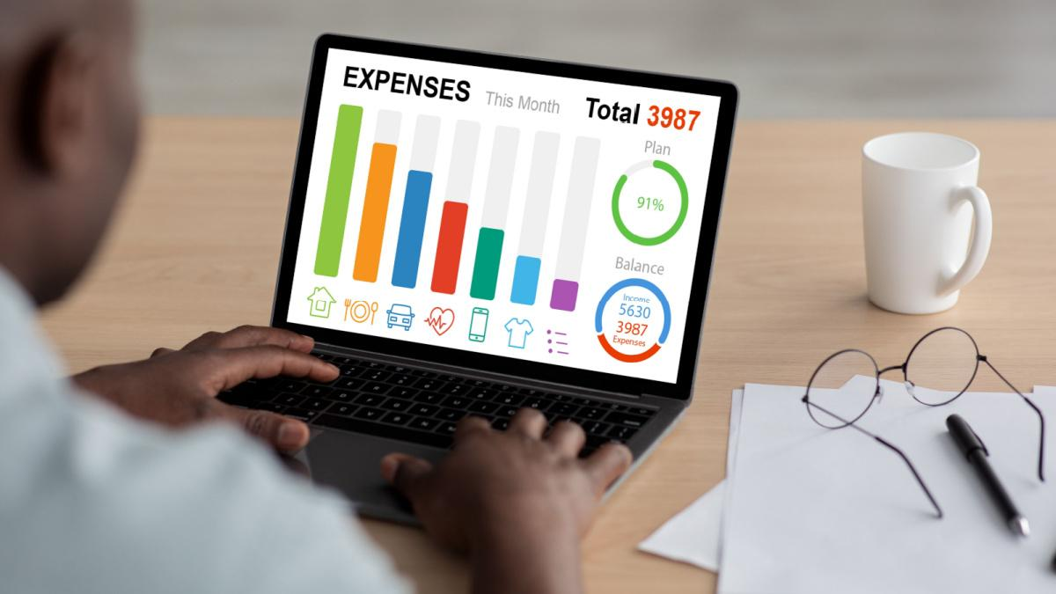
📊INTRODUCTION
Due to increasing monthly expenses, Nitin has been unable to save enough money to achieve his financial goal.
The project involves analysing June's expense data and the last six months of expense records to understand his spending behaviour.
The analysis is performed using Microsoft Excel, including Pivot Tables, Pivot Charts, and Conditional Formatting to organize and visualize the data.
The project identifies the highest expense categories, monthly spending trends, and non-essential expenses that can be reduced.

Slide 3
🎯PROBLEM STATEMENT
  Nitin works as a Graphic Designer in a new company. He earns Rs 15,000/- per month. He is planning to buy a scooter for his daily commute to the office.
  For the last couple of months, Nitin is not able to save at all for his scooter. His friend Ayush told him that he needed to figure out where most of the money goes and cut down that expense.
  Help Nitin increase his savings by removing some unnecessary expenses.

Slide 4
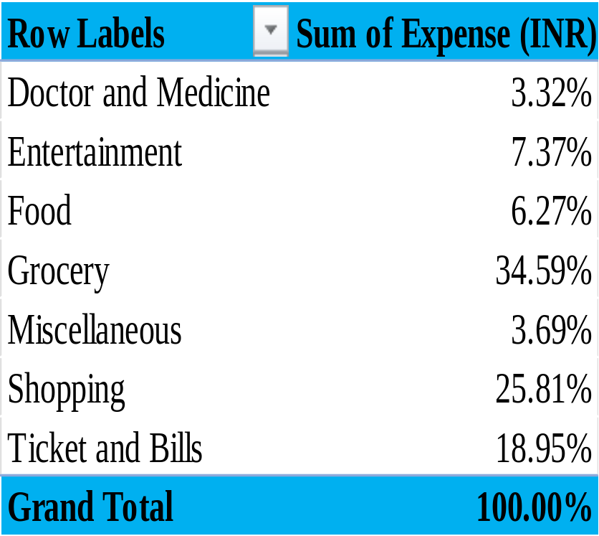
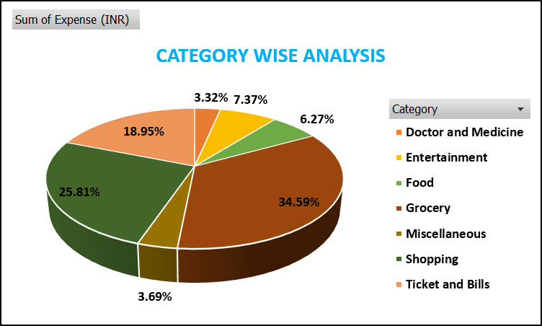
🔍 TASK - 1
1 How much is spent for each category (Pivot Table)
Visually represent the amount spent against each category is what percentage of the total expense amount (Pivot Chart)

Slide 5
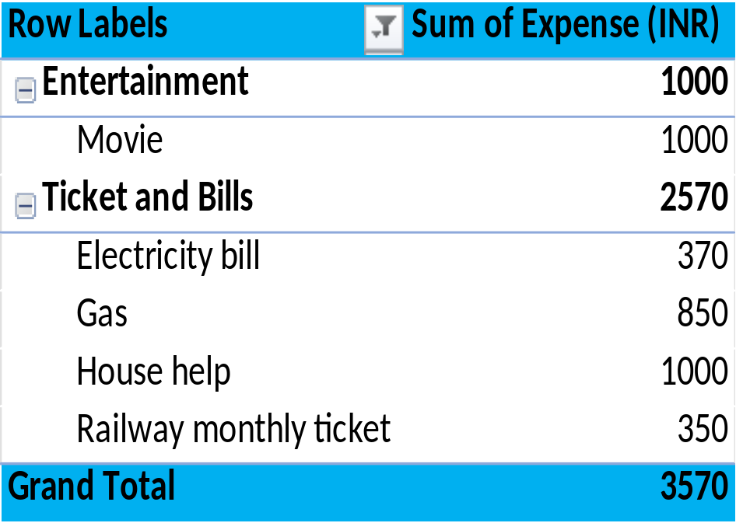
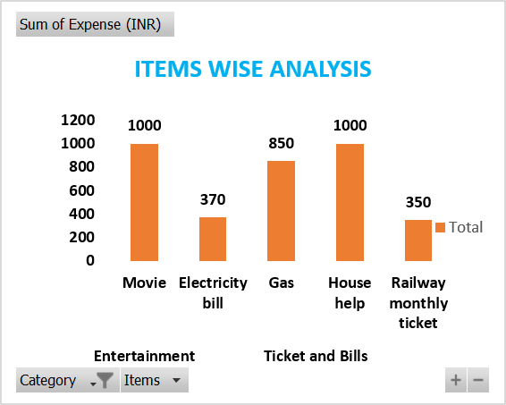
2. How much is spent on different items of each category (Pivot Table)
Visually represent the amount spent on different items of Entertainment and Tickets and bills category (Pivot Chart)

Slide 6
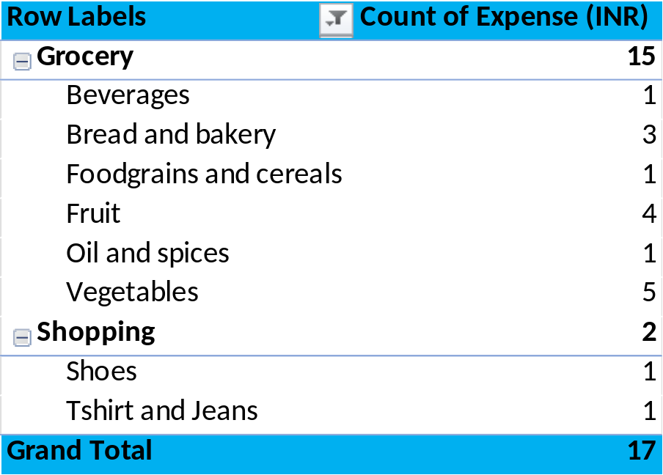
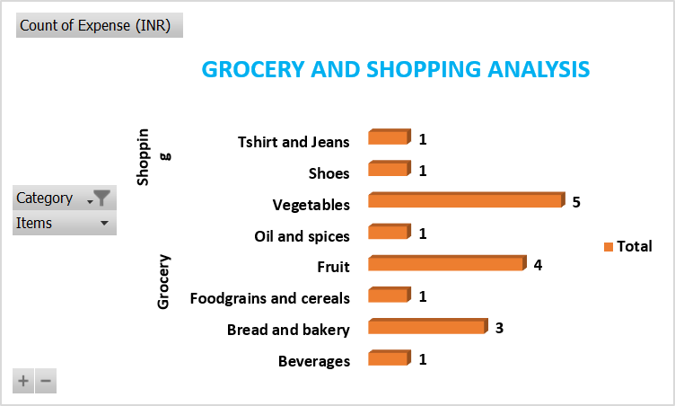
3. How many times money has been spent against different items of each
category (Pivot Table)
Filter the data to display the data for Grocery items and Shopping items

Slide 7
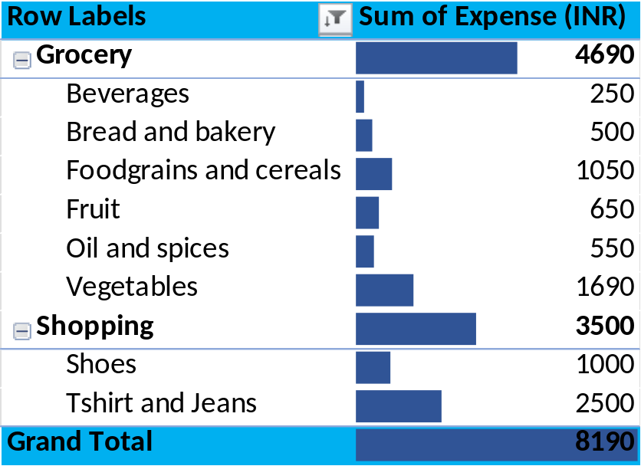
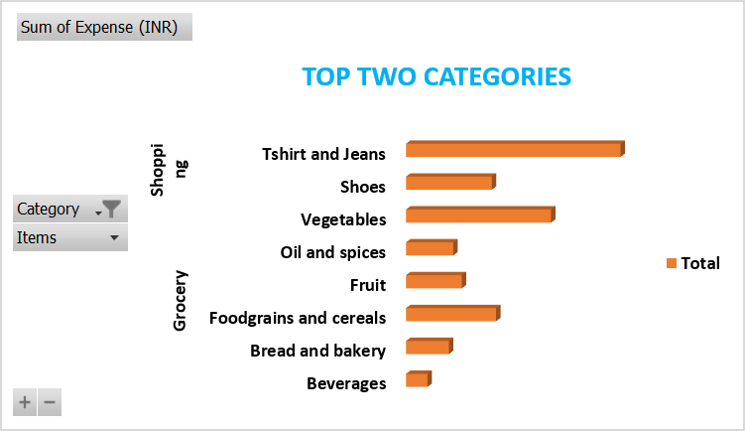
4. What amount is spent on each item of the categories with highest and
2nd highest expense amount (Pivot Table)
Visually represent the data with data bars (Conditional formatting)

Slide 8
💡Suggestions – June Month Analysis
Entertainment: Entertainment expenses are high in June. Reducing movie outings and other leisure activities can help increase savings.
Food: Spending on online food orders is high. Cooking at home and limiting food delivery can significantly reduce expenses.
Shopping: Avoid purchasing non-essential items and focus only on essential needs.
Budget Planning: Set a weekly budget and monitor daily expenses to avoid overspending.
Savings Goal: Transfer the amount saved from reduced expenses into a separate scooter savings account every month.

Slide 9
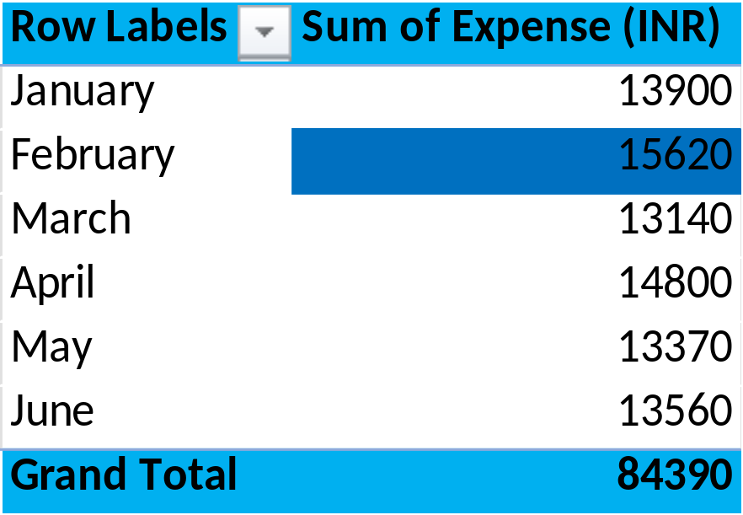
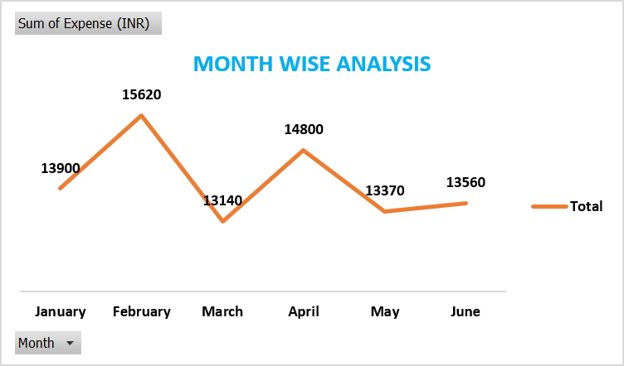
🔍 TASK - 2
1. Month-wise trend of expenses (Pivot table and chart)
Find out the month Nitin spent the most

Slide 10
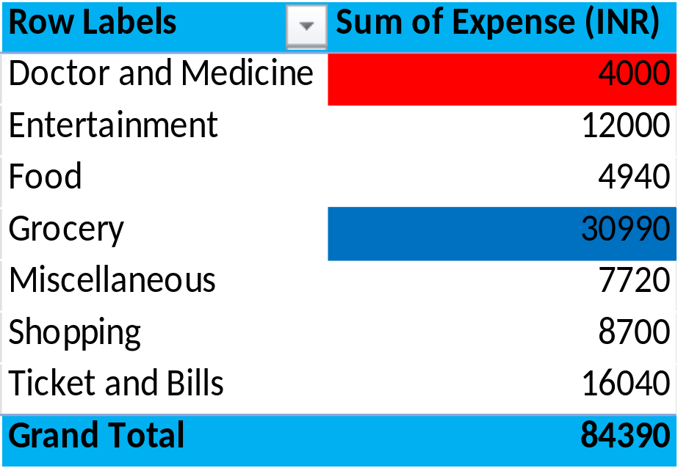
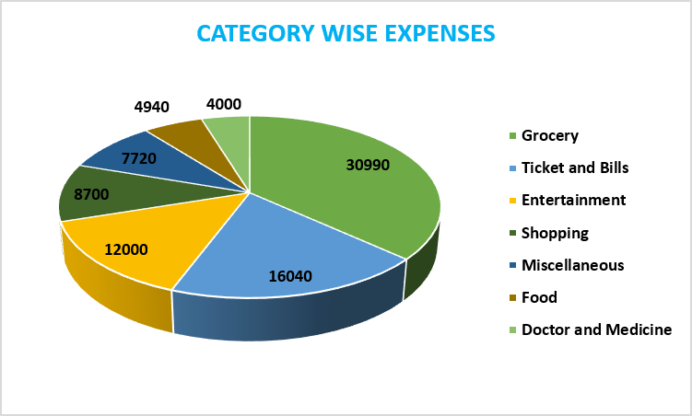
2. Category wise expenses (Pivot table)
Visually represent it with data bars to display categories with the highest and lowest expense amount

Slide 11
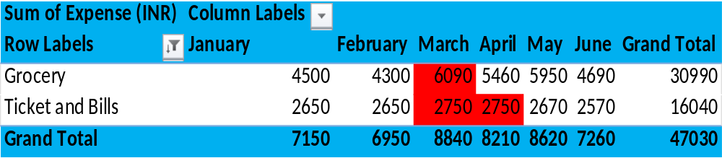
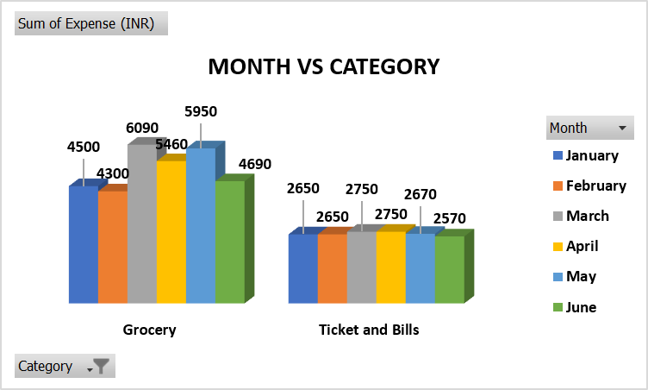
3. Month-wise expense of each category (Pivot table)
Find out 2 categories with higher expenses for each of the 6 months

Slide 12
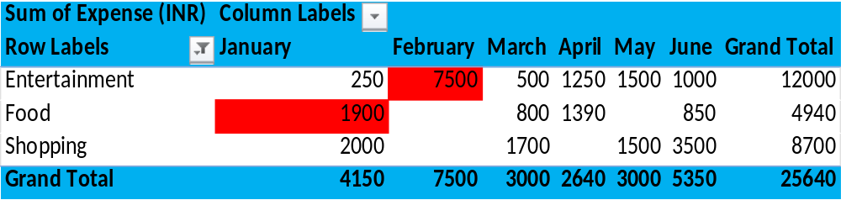
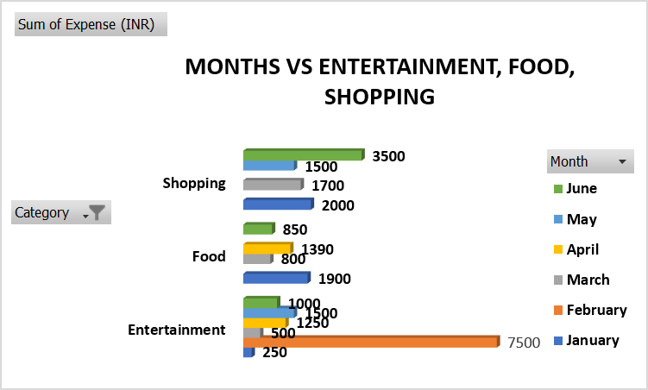
4. How much is spent in each month against different items of
Entertainment, Food and Shopping categories (Pivot table)
Find out which months have the highest amount spent for movies and dining out

Slide 13
💡Suggestions – Overall Six Months Analysis
Reduce Entertainment Expenses: Entertainment is one of the highest non-essential expense categories, mainly due to the North Bengal Trip (₹7,500), movies, and outings. Setting a monthly entertainment budget can significantly improve savings.
Control Shopping Expenses: Expenses on shirts, T-shirts, jeans, and shoes are high over the six months. Purchase clothes only when necessary and avoid impulse buying.
Limit Online Food Orders and Dining Out: Frequent spending on online food orders, dining out, chips, and snacks increases monthly expenses. Choosing home-cooked meals can reduce costs.
Manage Miscellaneous Expenses: Plan expenses such as gifts and other miscellaneous purchases in advance to avoid unnecessary spending.

Slide 14
Use Discounts and Cashback Offers: While purchasing essential items like groceries, Nitin can make use of discounts, offers, and cashback to reduce overall expenses.
Maintain Essential Expenses Efficiently: Grocery, Ticket & Bills, and Doctor & Medicine are essential expenses. Continue managing them wisely without affecting daily needs.
Follow a Monthly Budget: Allocate a fixed amount for each expense category and monitor spending regularly to avoid exceeding the budget.
Increase Monthly Savings: Save a fixed portion of the salary (20–30%) every month in a separate scooter savings fund before spending on non-essential items.

Slide 15

🛵CONCLUSION
The six-month expense analysis shows that Entertainment, Shopping, and Outside Food are the major non-essential spending categories, while Grocery, Ticket & Bills, and Doctor & Medicine are essential expenses. By reducing unnecessary spending on entertainment, shopping, and online food, and by following a disciplined monthly budget and savings plan, Nitin can steadily increase his savings and achieve his goal of purchasing a scooter without compromising his essential needs.

Slide 16


